Slide 1
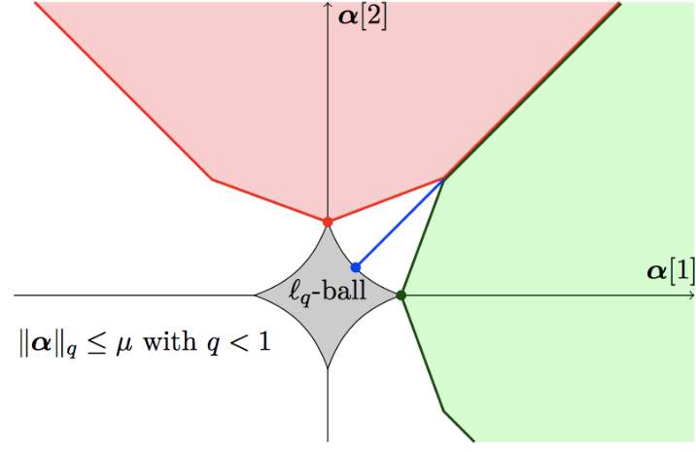
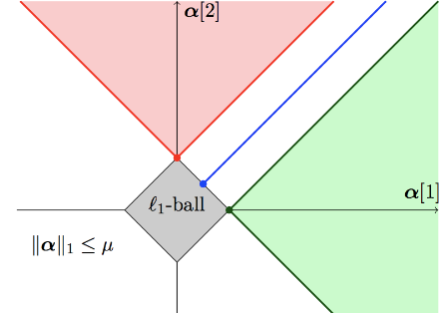
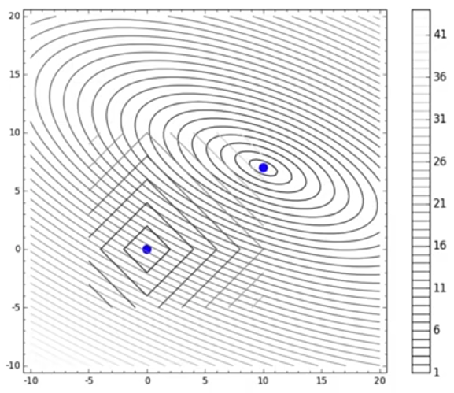
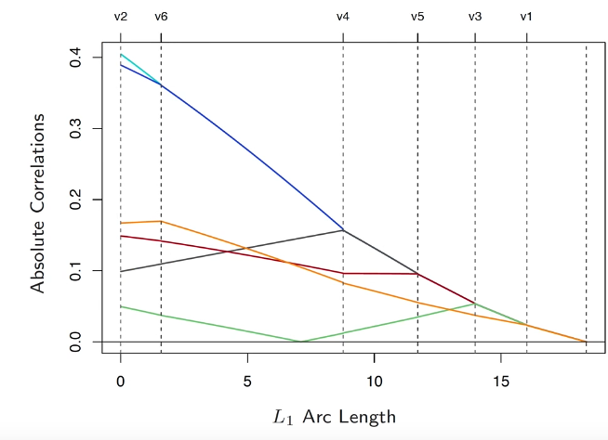
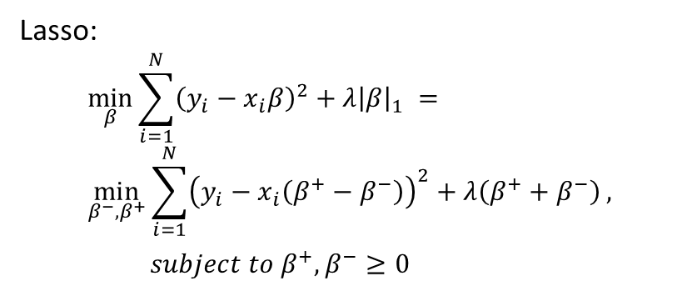
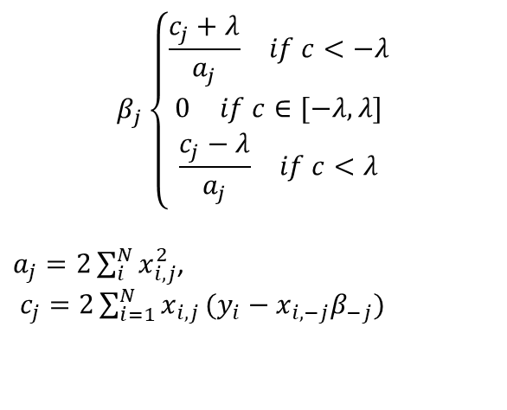
Lecture 3
Lasso:
$$\min_{β}{\sum_{i=1}^{N}{{\left(y_{i}−x_{i}β\right)}^{2}+λ{\left|β\right|}_{1} }}= \\ \min_{β^{−},β^{+}}{\sum_{i=1}^{N}{{\left(y_{i}−x_{i}\left(β^{+}−β^{−}\right)\right)}^{2}+λ\left(β^{+}+β^{−}\right)}},$$ $subject to β^{+},β^{−}≥0$
Solve the optimization:
LARS or Coordinate Descent.
Coordinate Descent has a closed form
$$β_{j}\left\{\begin{aligned}\begin{matrix}\frac{c_{j}+λ}{a_{j}} & if c<−λ\end{matrix} \\ \begin{matrix}0 & if c∈[−λ,λ]\end{matrix} \\ \begin{matrix}\frac{c_{j}−λ}{a_{j}} & if c<λ\end{matrix}\end{aligned}\right.$$
$a_{j}=2\sum_{i}^{N}{x_{i,j}^{2}}$,
$c_{j}=2\sum_{i=1}^{N}{x_{i,j}}(y_{i}−x_{i,−j}β_{−j})$

Slide 2
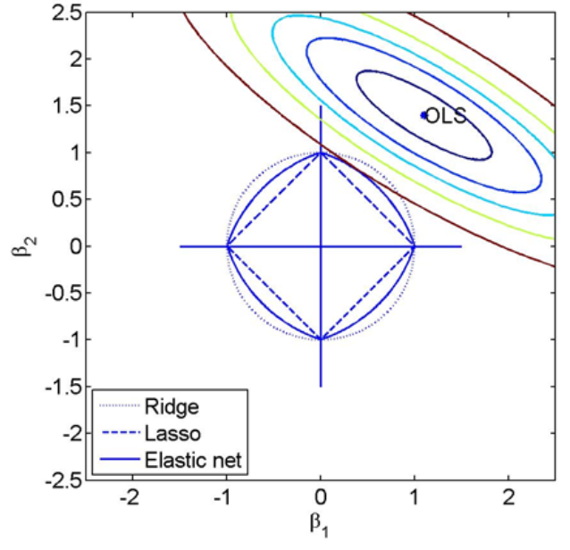
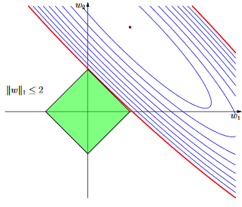
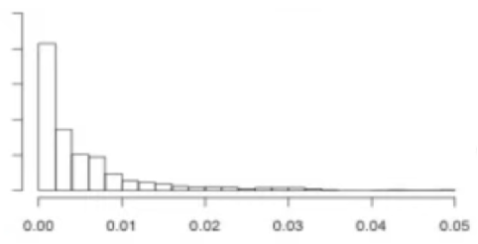
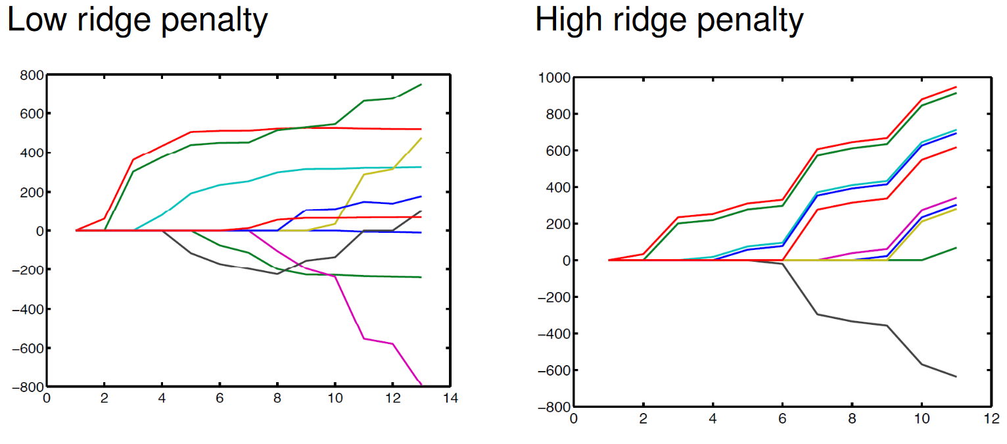
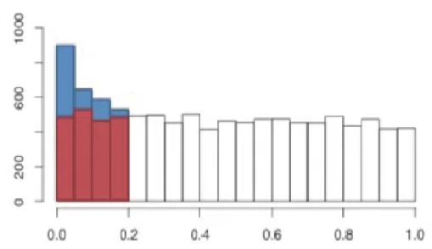
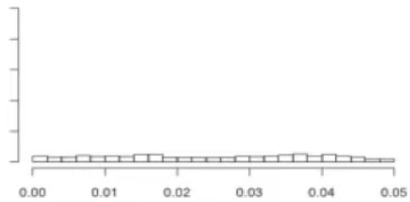
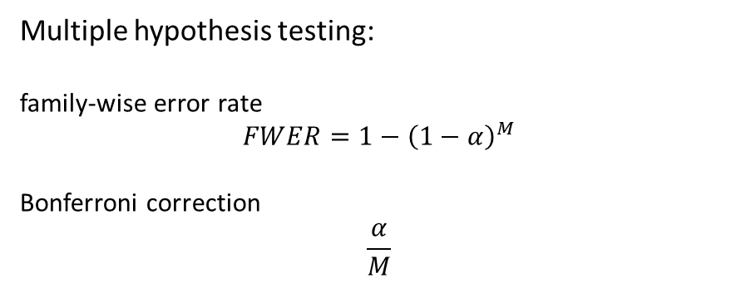
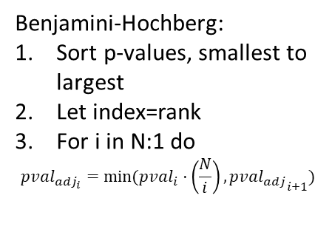
Lecture 3
Elastic net:
Multiple hypothesis testing:
family-wise error rate
$$FWER=1−{\left(1−α\right)}^{M}$$
Bonferroni correction
$$\frac{α}{M}$$
Benjamini-Hochberg:
Sort p-values, smallest to largest
Let index=rank
For i in N:1 do
$$pval_{adj_{i}}=min⁡(pval_{i}⋅\left(\frac{N}{i}\right),pva{l_{adj}}_{i+1})$$
Notes:
Benjamini-Hochberg:
Gain: We control false positives - added power.
Cost: Increased number of false negatives.

